Slide 1



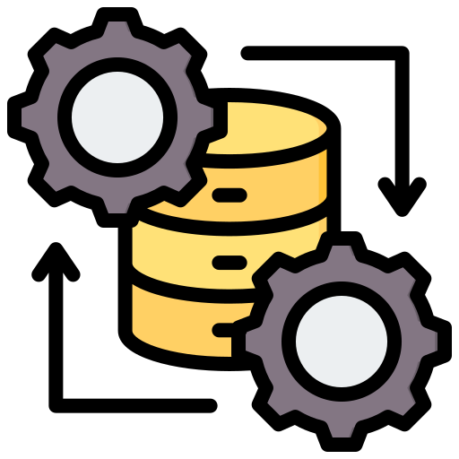
Enabling Distributed Flexibility: Key Regulatory and Technical Needs (1)
1. Legal Basis and Roles
The NC DR must stay aligned with the EU’s legal framework while respecting national differences in energy systems. We recommend maintaining flexibility for Member States to define responsibilities in line with their national frameworks.
2. Harmonisation and National Implementation
While harmonisation is important, rigid and short EU deadlines may disrupt national implementation and increase costs. ENTSO-E proposes more phased approach for harmonization, based on evidence from NC DR Implementation monitoring.
3. Reliability and Security
Flexibility must not compromise reliability. Proposals such as reducing minimum balancing bid size could add risk and complexity, despite small assets already having access to markets through aggregation.
4. Standardised Data Exchange
ENTSO-E supports a pragmatic, standards-based approach to data exchange, relying on existing ETSI-CEN-CENELEC standards wherever possible. Together with the EU DSO Entity, ENTSO-E should publish and maintain a list of preferred European standards, while ensuring the list reflects market maturity, innovation needs, implementation costs, and evolving standardisation developments.

Slide 2



Enabling Distributed Flexibility: Key Regulatory and Technical Needs (2)
5. Connection Requirements
ENTSO-E would also highlight that the harmonisation of connection requirements is an important enabler for distributed flexibility resources. The Requirements for Generators and Demand Connection Network Codes can support a more consistent framework for the connection and operation of DER assets. In addition, ENTSO-E recommends that additional and tailor-made connection requirements for data centres should be considered.
6. Cybersecurity risk
ENTSO-E stresses that the rapid growth of small-scale connected assets must be accompanied by stronger cybersecurity requirements. Existing distributed resources may have uneven cybersecurity standards and could create system-level vulnerabilities if exposed to coordinated attacks. Going forward, cybersecurity-by-design should be embedded in the next wave of small-scale assets, supported by clear standards, certification and monitoring.
7. Observability & controllability:
ENTSO-E advocates for unlocking the full flexibility potential of RES, particularly during periods of high generation and low demand. This requires improving the observability and controllability of RES assets by:
The rollout of smart and granular metering systems to make assets observable;
Standardised control interfaces and data exchange between plant operators, Balance Responsible Parties, and system operators;
Financial and regulatory frameworks that encourage RES to adjust generation dynamically and participate in balancing and system services.

